Slide 1
Agenda: Phishing Awareness for Our Teams
Recent security test showed two teams more at risk
HR/Marketing
Today’s goal: learn quick ways to spot phishing before it spreads.
🔒
Notes:
Hi everyone! Thanks for joining this short session. Our recent phishing simulation showed a few areas we can strengthen, so this isn’t about blame, it’s about getting smarter together. We’ll cover what phishing is, how to spot it fast, and simple habits that protect us all. Let’s start with the basics.

Slide 2
So what is phishing???
🔒
Fake emails or messages that look real.
Designed to steal passwords, data, or money.
Often uses urgency, fear, or curiosity.
Can appear from “trusted” names or brands.
Also happens through calls or texts — voice phishing (vishing) and SMS phishing (smishing).
Notes:
Phishing is basically a scam in your inbox where there are messages pretending to be someone you trust. They want you to click, share info, or send money. And it’s not just email because attackers also use calls, known as voice phishing or vishing, and texts, called smishing. They can sound convincing, but there are always clues such as odd wording, fake domains, or pushy requests. Let’s look at how attackers make these messages believable.

Slide 3
Learn to spot phishing emails
🔒
Urgency & fear: “Reset now or account locked” — pushes you to act without thinking.
Look-alike senders / domains: display name looks right but the email is slightly off (e.g., it-support@mastercard-security.com).
Masked links: visible text says “Reset Password” but the link target points elsewhere.
Familiar names / spoofing: messages that appear to come from executives or colleagues asking for approvals or info.
Malicious attachments: invoices, PDFs or Office files that request macros or enable editing.
Quick note: same tricks appear in SMS (smishing) and phone calls (vishing), but email remains the highest-volume attack vector.
Notes:
Attackers use predictable tricks to create urgency and trust. With email they’ll fake a sender, hide where a link actually goes, or attach files that look legitimate like invoices or HR forms. Smishing (texts) and vishing (calls) use similar psychological pressure, but today we’re focusing on email because it’s where most compromises start. When you see pressure, unexpected attachments, or anything that asks for credentials, you should stop, hover the link, and verify.

Slide 4
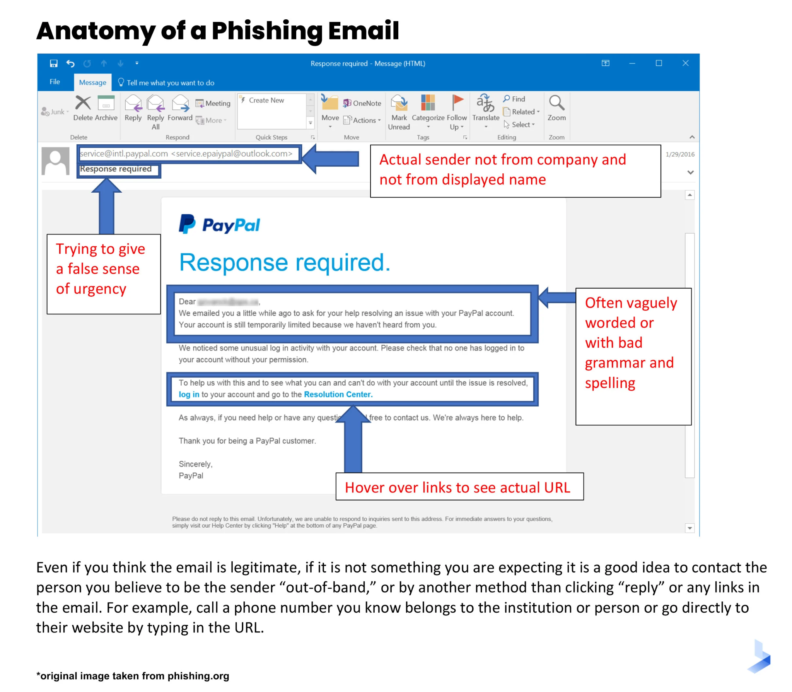
🔒
Notes:
Here’s a great example of how a phishing email looks in the wild.
Now, I know what you’re thinking. ‘Wait, why does it say PayPal if we work for Mastercard?’ That’s actually the point. Attackers don’t always go straight for your work account. They might start by getting to know you through personal services like PayPal, Amazon, or even social media. Once they gain your trust or learn your habits, they can craft a more believable email targeting your corporate account later.
Notice the tricks here: a false sense of urgency, a sender address that doesn’t actually match the brand, and vague or awkward language.
One of the best habits you can develop is hovering over links before clicking. It’s like taking a peek behind the curtain and you’ll often see that the URL doesn’t lead where you expect.
So while this example uses PayPal, the takeaway applies everywhere which is that attackers will impersonate any brand, company, or colleague if it helps them get a click.

Slide 5
How do we stop getting phished?
🔒
Hover links before clicking — verify the domain (mouse-over on desktop; long-press on mobile).
Inspect the full sender address — don’t trust the display name alone.
Question urgency — pause any email demanding immediate action or secrecy.
Don’t enable macros / edit mode in attachments — treat attachments as suspicious unless expected.
Verify high-risk asks (payments, credentials, wire transfers) via a separate channel (call the person).
Report immediately — forward suspicious emails to security@mastercard.com (do not reply).
Notes:
Here’s what I want you to walk away with: pause before you click. Hover links, check the full email address, and if something asks for credentials or money, you can call to confirm. If you’re unsure, forward it to security@mastercard.com instead of replying. We’ll send a short 3-minute refresher after this; please complete it. Thank you all, your attention is one of our best defenses.

